Slide 1
Chapter 7: Database Administration and Security
Based on Chapter 11: Data and Database Administration
Modern Database Management
11th Edition
Jeffrey A. Hoffer, V. Ramesh,
Heikki Topi

Slide 2
Objectives
Define terms
List functions and roles of data/database administration
Describe role of data dictionaries and information repositories
Compare optimistic and pessimistic concurrency control
Describe problems and techniques for data security
Understand role of databases in Sarbanes-Oxley compliance
Describe problems and facilities for data recovery
Describe database tuning issues and list areas where changes can be done to tune the database
Describe importance and measures of data availability

Slide 3
Ineffective data administration ➔ poor data quality
Multiple data definitions, causing data integration problems
Missing data elements, causing reduction in data value
Inappropriate data sources and timing, causing lowered reliability
Inadequate familiarity, causing ineffective use of data for planning and strategy
Poor response time and excessive downtime
Damaged, sabotaged, and stolen data
Unauthorized access, leading to embarrassment to organization

Slide 4
Traditional Administration Definitions
Data Administration: A high-level function that is responsible for the overall management of data resources in an organization, including maintaining corporate-wide definitions and standards
Database Administration: A technical function that is responsible for physical database design and for dealing with technical issues such as security enforcement, database performance, and backup and recovery

Slide 5
Traditional Data Administration Functions
Data policies, procedures, standards
Planning
Data conflict (ownership) resolution
Managing the information repository
Internal marketing of DA concepts

Slide 6
Traditional Database Administration Functions
Analyzing and designing databases
Selecting DBMS and software tools
Installing/upgrading DBMS
Tuning database performance
Improving query processing performance
Managing data security, privacy, and integrity
Data backup and recovery

Slide 7
Data Warehouse Administration
New role, coming with growth in data warehouses
Similar to DA/DBA roles
Emphasis on integration and coordination of metadata/data across many data sources
Specific roles:
Support decision support applications
Manage data warehouse growth
Establish service level agreements regarding data warehouses and data marts

Slide 8
Open Source DB Management
An alternative to proprietary packages such as Oracle, Microsoft SQL Server, or Microsoft Access
MySQL is an example of an open-source DBMS
Less expensive than proprietary packages
Source code available, for modification
Absence of complete documentation
Ambiguous licensing concerns
Not as feature-rich as proprietary DBMSs
Vendors may not have certification programs

Slide 9
IT Operations
Policies and procedures for day-to-day management of infrastructure, applications, and databases in an organization
For databases:
Backup & recovery
Availability

Slide 10
Database Recovery
Mechanism for restoring a database quickly and accurately after loss or damage
Recovery facilities:
Backup Facilities
Journalizing Facilities
Checkpoint Facility
Recovery Manager

Slide 11
Back-up Facilities
DBMS copy utility that produces backup copy of the entire database or subset
Periodic backup (e.g. nightly, weekly)
Cold backup–database is shut down during backup
Hot backup–selected portion is shut down and backed up at a given time
Backups stored in secure, off-site location

Slide 12
Journalizing Facilities
Audit trail of transactions and database updates
Transaction log–record of essential data for each transaction processed against the database
Database change log–images of updated data
Before-image–copy before modification
After-image–copy after modification
Produces an audit trail

Slide 13
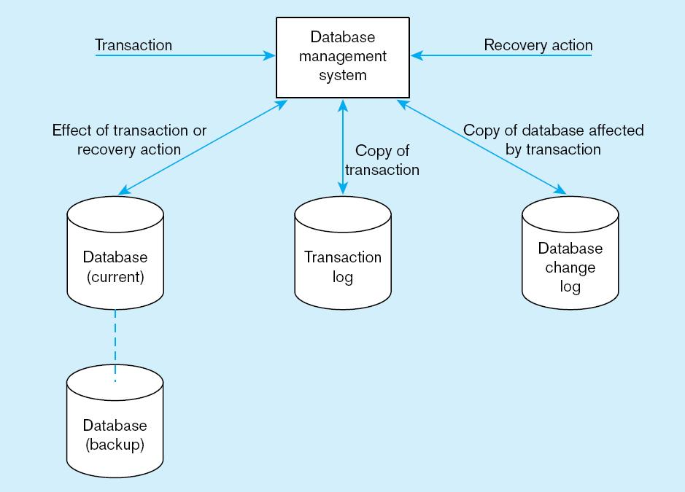
Figure 11-8 Database audit trail
From the backup and logs, databases can be restored in case of damage or loss
Chapter 11
© 2013 Pearson Education, Inc. Publishing as Prentice Hall
13

Slide 14
Checkpoint Facilities
DBMS periodically refuses to accept new transactions
➔ system is in a quiet state
Database and transaction logs are synchronized
This allows recovery manager to resume processing from short period, instead of repeating entire day

Slide 15
Recovery and Restart Procedures
Disk Mirroring–switch between identical copies of databases
Restore/Rerun–reprocess transactions against the backup
Transaction Integrity–commit or abort all transaction changes
Backward Recovery (Rollback)–apply before images
Forward Recovery (Roll Forward)–apply after images (preferable to restore/rerun)

Slide 16
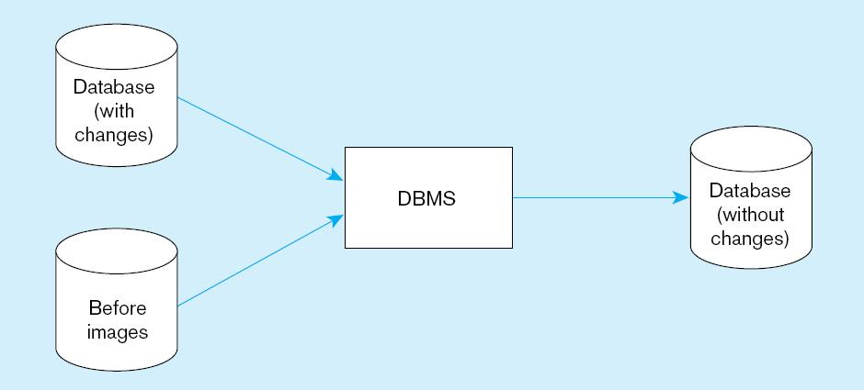
Figure 11-9 Basic recovery techniques
a) Rollback
Chapter 11
© 2013 Pearson Education, Inc. Publishing as Prentice Hall
16

Slide 17
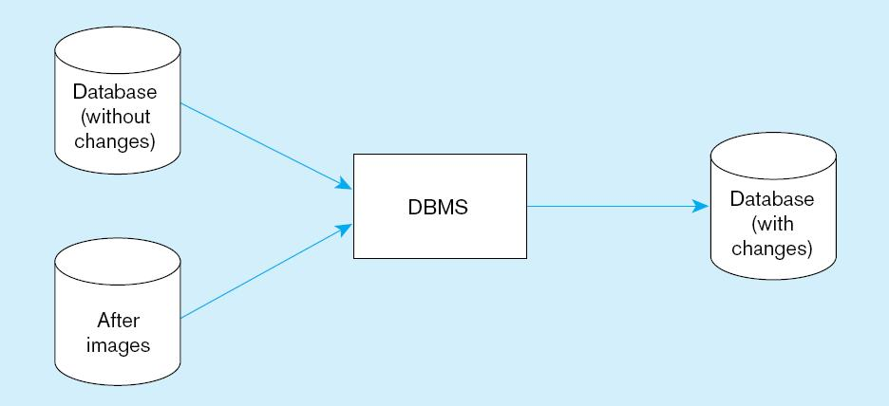
Figure 11-9 Basic recovery techniques (cont.)
b) Rollforward
Chapter 11
© 2013 Pearson Education, Inc. Publishing as Prentice Hall
17

Slide 18
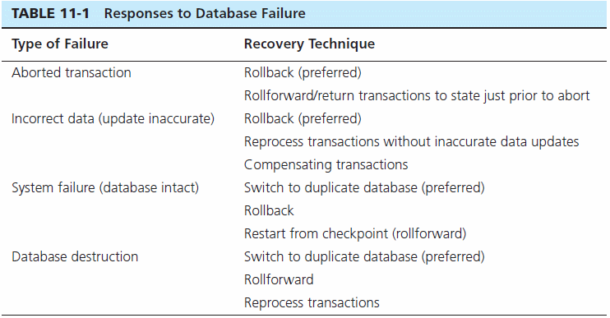

Slide 19
Data Availability
How to ensure availability
Hardware failures–provide redundancy for fault tolerance
Loss of data–database mirroring
Human error–standard operating procedures, training, documentation
Maintenance downtime–automated and non-disruptive maintenance utilities
Network problems–careful traffic monitoring, firewalls, and routers

Slide 20
Data Security
Database Security: Protection of the data against accidental or intentional loss, destruction, or misuse
Increased difficulty due to Internet access and client/server technologies

Slide 21
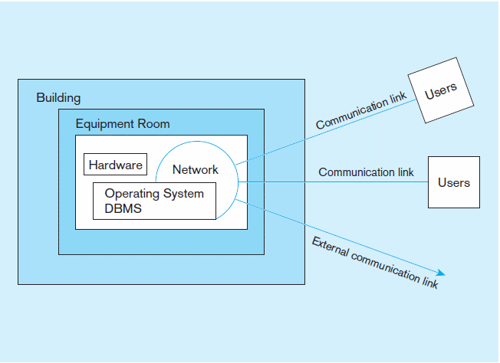
Figure 11-2 Possible locations of data security threats
Chapter 11
© 2013 Pearson Education, Inc. Publishing as Prentice Hall
21

Slide 22
Threats to Data Security
Accidental losses attributable to:
Human error
Software failure
Hardware failure
Theft and fraud
Loss of privacy or confidentiality
Loss of privacy (personal data)
Loss of confidentiality (corporate data)
Loss of data integrity
Loss of availability (e.g., through sabotage)

Slide 23
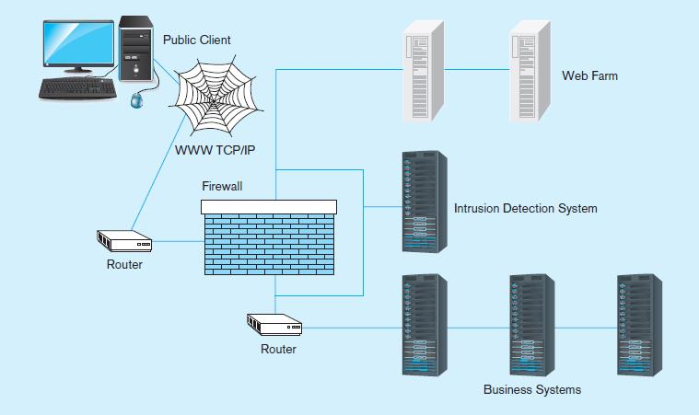
Figure 11-3 Establishing Internet Security
Chapter 11
© 2013 Pearson Education, Inc. Publishing as Prentice Hall
23

Slide 24
Client – Server Application security
Static HTML files are easy to secure
Standard database access controls
Place Web files in protected directories on server
Dynamic pages are harder
User authentication
Session security
SSL for encryption
Restrict number of users and open ports
Remove unnecessary programs

Slide 25
W3C Web Privacy Standard
Platform for Privacy Protection (P3P)
Addresses the following:
Who collects data
What data is collected and for what purpose
Who is data shared with
Can users control access to their data
How are disputes resolved
Policies for retaining data
Where are policies kept and how can they be accessed

Slide 26
Database Software Security Features
Views or subschemas
Integrity controls
Authorization rules
User-defined procedures
Encryption
Authentication schemes
Backup, journalizing, and checkpointing

Slide 27
Views and Integrity Controls
Views
Subset of the database that is presented to one or more users
User can be given access privilege to view without allowing access privilege to underlying tables
Integrity Controls
Protect data from unauthorized use
Domains–set allowable values
Assertions–enforce database conditions
Triggers – prevent inappropriate actions, invoke special handling procedures, write to log files

Slide 28
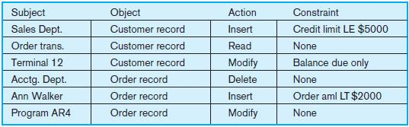
Authorization Rules
Controls incorporated in the data management system
Restrict:
access to data
actions that people can take on data
Authorization matrix for:
Subjects
Objects
Actions
Constraints
Figure 11-4 Authorization matrix

Slide 29
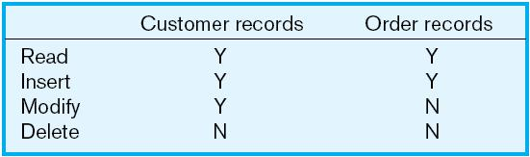
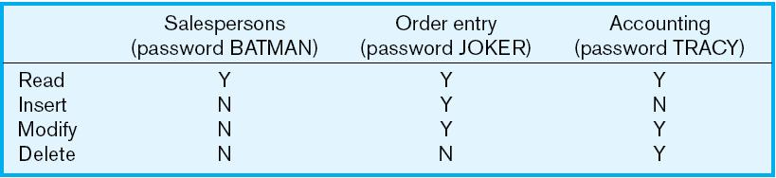
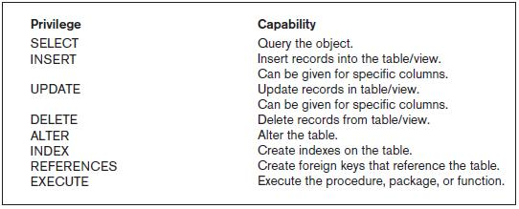
Figure 11-5a Authorization table for subjects (salespersons)
Implementing authorization rules
Figure 11-5b Authorization table for objects (orders)
Figure 11-6 Oracle privileges
Some DBMSs also provide capabilities for user-defined procedures to customize the authorization process.
Chapter 11
© 2013 Pearson Education, Inc. Publishing as Prentice Hall
29

Slide 30
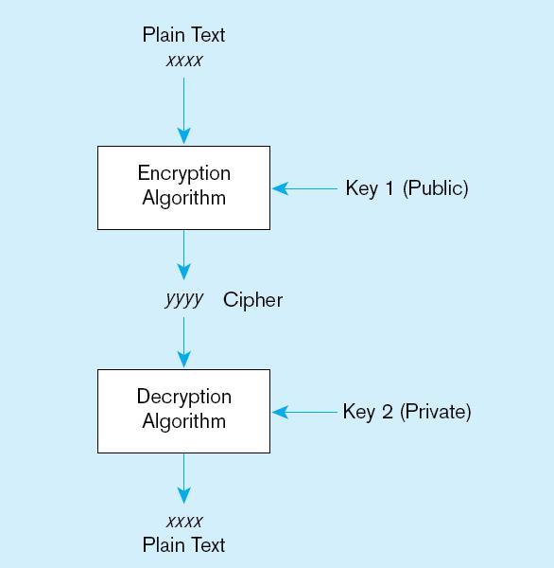
Figure 11-7 Basic two-key encryption
Encryption – the coding or scrambling of data so that humans cannot read them
Secure Sockets Layer (SSL) is a popular encryption scheme for TCP/IP connections.
Chapter 11
© 2013 Pearson Education, Inc. Publishing as Prentice Hall
30

Slide 31
Authentication Schemes
Goal – obtain a positive identification of the user
Passwords: First line of defense
Should be at least 8 characters long
Should combine alphabetic and numeric data
Should not be complete words or personal information
Should be changed frequently

Slide 32
Authentication Schemes (cont.)
Strong Authentication
Passwords are flawed:
Users share them with each other
They get written down, could be copied
Automatic logon scripts remove need to explicitly type them in
Unencrypted passwords travel the Internet
Possible solutions:
Two factor–e.g., smart card plus PIN
Three factor–e.g., smart card, biometric, PIN

Slide 33
Logical Access to Data
Personnel controls
Hiring practices, employee monitoring, security training, separation of duties
Physical access controls
Swipe cards, equipment locking, check-out procedures, screen placement, laptop protection

